Slide 1

WTF is it?

Slide 2
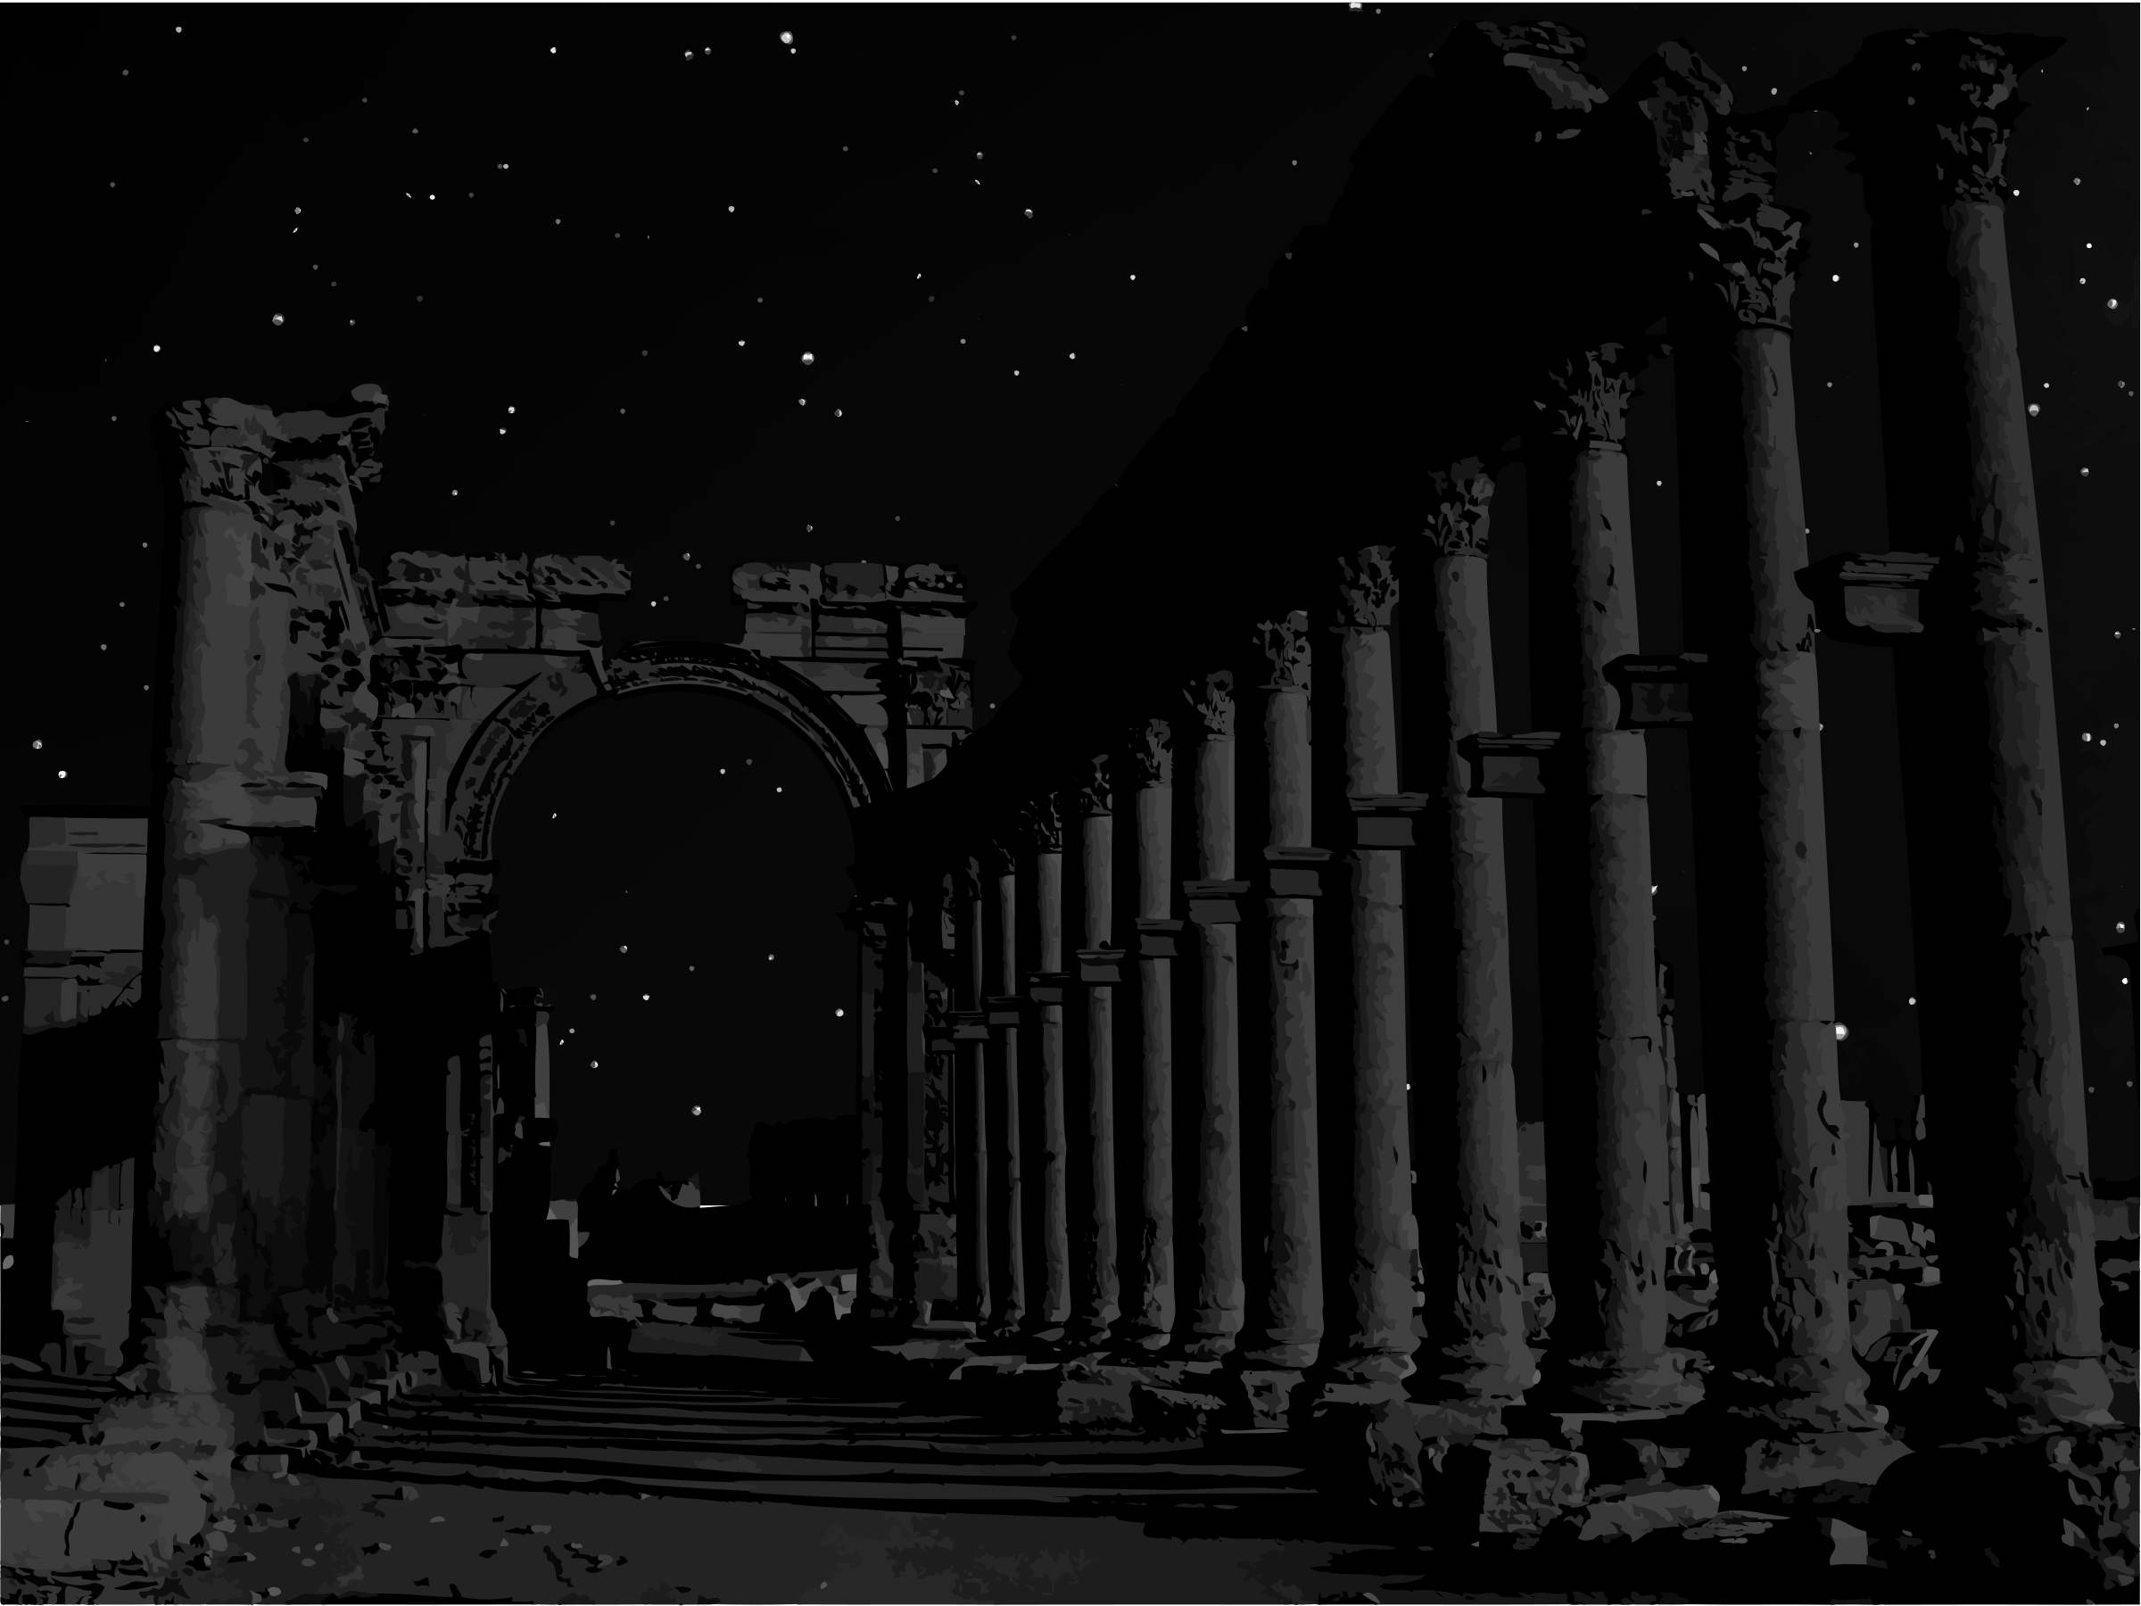
2008 saw both a breakdown of trust with the collapse of sprawling financial markets, and the birth of a new model for trust with Blockchains, and Cryptocurrencies.

Slide 3
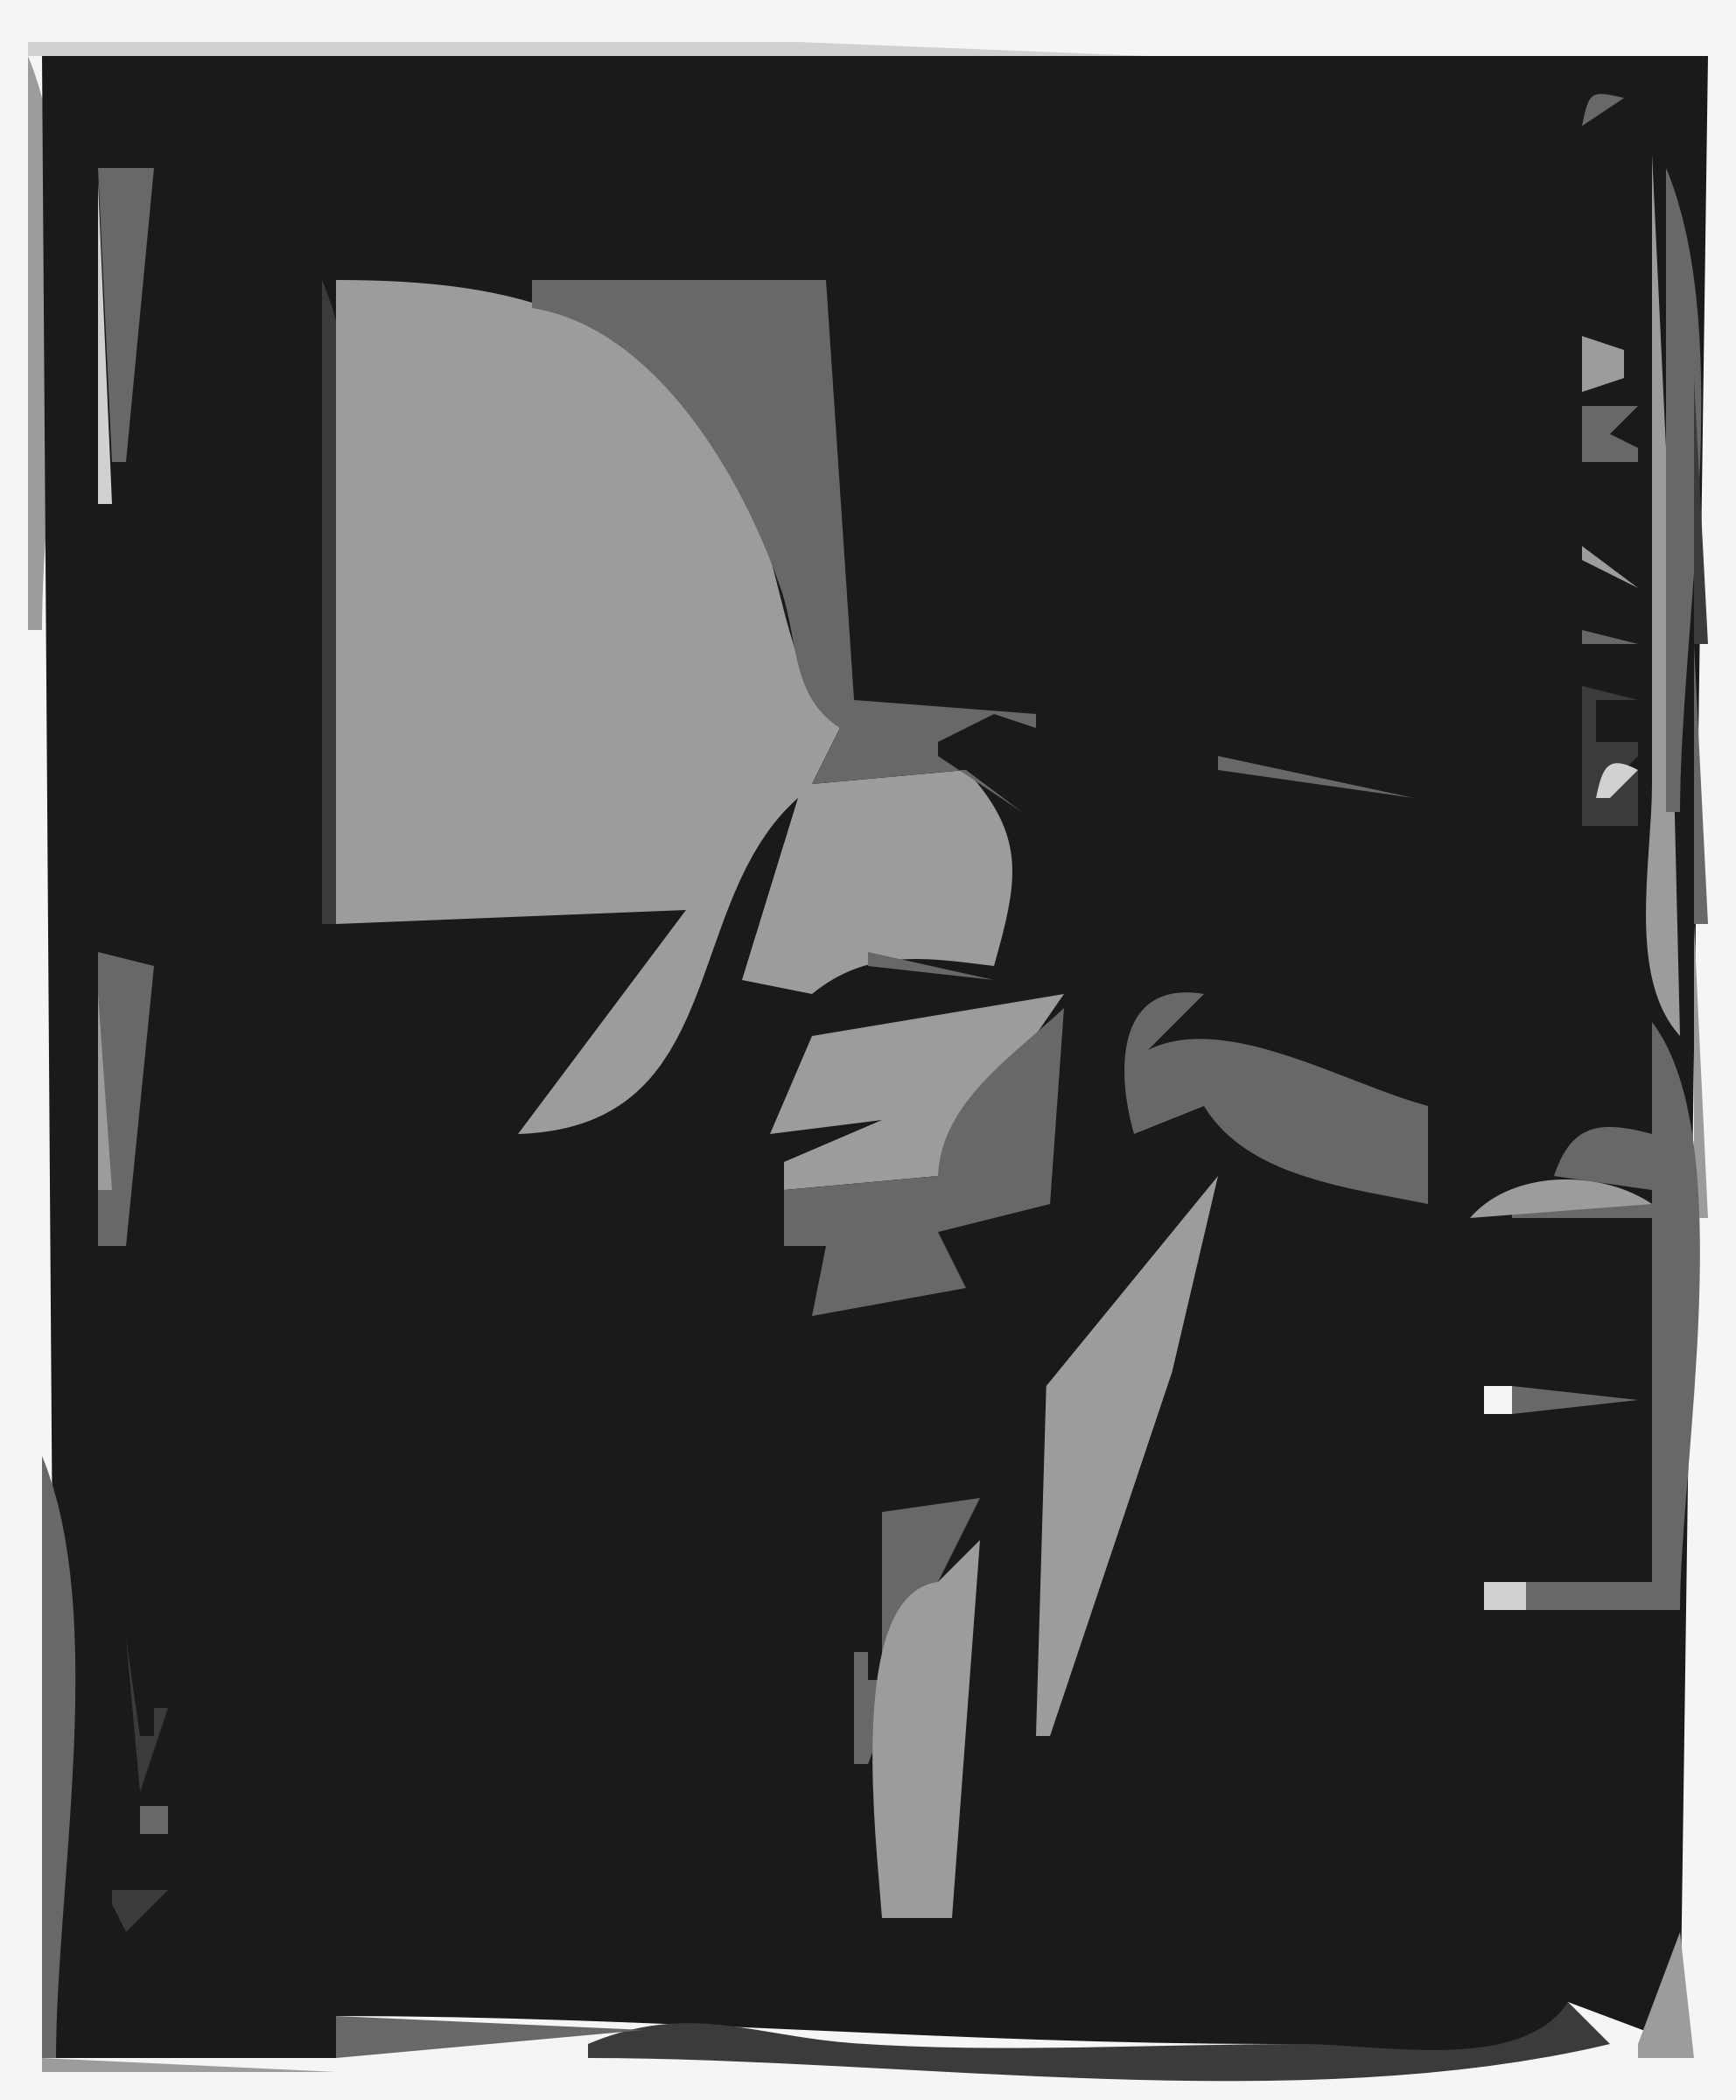
The innovators, and change makers of this world got excited about the new possibilities to organise collectively, and exchange value.
Banking without banks, borrowing without loans,
funding without equity...

Slide 4

What the story leaves out is that blockchain cannot deliver on its promises of a decentralised world.
Holochain is the post-blockchain technology that will.

Slide 5
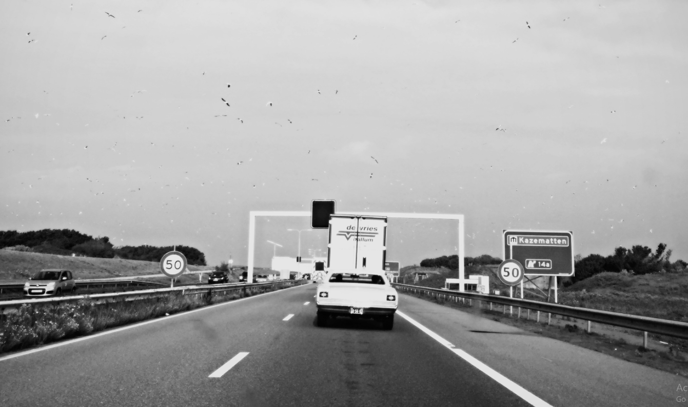
Holochain eliminates bottlenecks that make blockchains unfit to build the decentralized world we want.

Slide 6
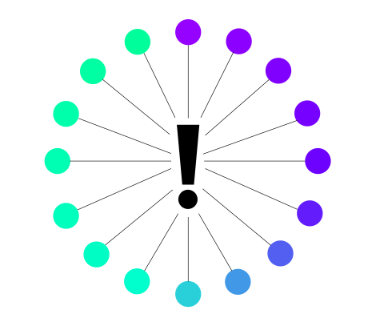
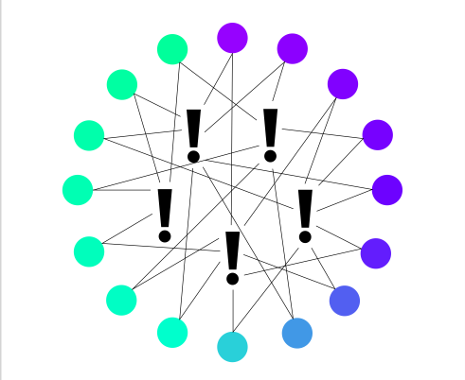

TRADITIONAL BLOCKCHAIN
HOLOCHAIN
Centralized network-wide consensus validation 99.99% of data created is discarded Network MUST update in unison, creating a supercomputer that can only process one perspective Trust is network-wide or bust
Distributed network for individualized validation All data is held, and is considered valuable Network updates in parallel instead of in unison Trust generated on an individual basis

Slide 7
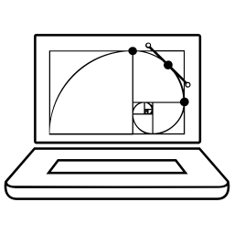
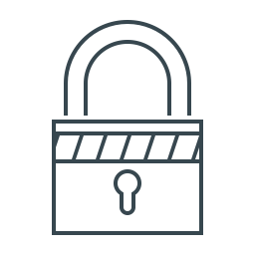


Holochain is less volatile than a traditional blockchain because the architecture is:
SCALABLE
SECURE
ENERGY EFFICIENT
COST EFFECTIVE
● Network efficiency increases parallel to scale
● Incentive driven network capacity
● Virtuous feedback loops keep capacity in step with demand
● Distributed architecture
● No centralized points of failure
● Larger and more complex attack surfaces
● No consensus means no expensive hardware needed for validation
● No outrageous power costs to run the equipment ● Lightweight enough to run on mobile phones and IoT devices
● Cheap transactions: What costs $10,000 on Ethereum costs $1 on Holochain
● Cheap development: No smart contract developer scarcity: just javascript and Rust
● Cheap hosting: distributed hosting gets cheaper as the network grows

Slide 8
What does Holochain enable?
Own your data, control who has access to it and when
Lets the crowd put itself in the cloud
New types of applications with more flexibility of use and interaction
Fast microtransactions that can handle credit card-scale payment processing
Adaptable solutions from distributed P2P networks to robust localized systems
Interoperability of Apps, freedom of association and connection

Slide 9
Existing Applications
THIS IS A SPOT TO TALK ABOUT ENABLING HOLO
Clutter - a distributed version of Twitter
Holo Chat - Multi-room P2P chat (like a distributed Slack)
FractalWiki - a Hierarchical wiki
Cointoss - an app for trustable random initiation

Slide 10
Emerging Applications
ARTIFICIAL
INTELLIGENCE
QUANTUM
COMPUTING
IoT
BIOTECHNOLOGY
Smart Homes
Wearables
Smart Grid
Smart City
Smart Supply Chain
Financial Management
Robotic Automation
Customer Service
Data Analytics
Medical Applications
Integer Factorization
Quantum Cryptography
Molecular Modeling
Protein Folding
Genomics Research
Genomics Research
Agriculture Applications
Bioenergy Providers
Bioinformatics
Chemical Engineering

Slide 11
Example Emerging Applications
A rideshare app run by riders and drivers, without a monopoly in the middle dictating terms. Holo hosts would get paid for helping host a website where anyone can book a ride.
An Emergency Response app to coordinate in the aftermath of a disaster, without needing a connection to a Silicon Valley data center. Unlike today's centralized applications, apps on Holo run just fine on a local network, or an on-the-fly mesh deployment.
A community of rural homeowners who generate, store, and share electricity using solar panels, windmills, small water turbines, and backup batteries. Holochain is designed to handle exactly these sorts of micro-transactions.

Slide 12
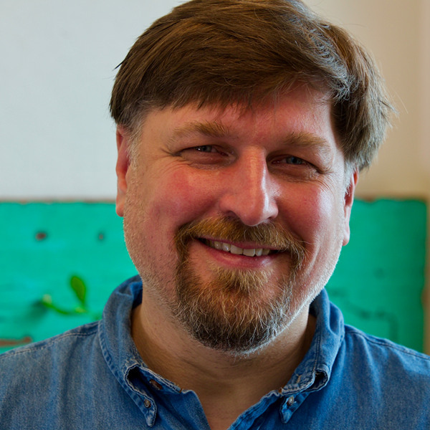
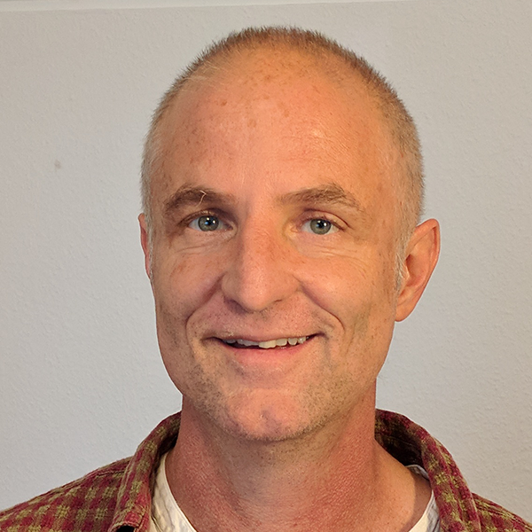

The Team
Arthur Brock
Cofounder
Eric Harris-Braun
Cofounder
Matthew Schutte
Director of Communications
Holochain has a distributed multinational team of X people operating in X countries. With backgrounds from X, to X, to X, the organization is designed for resilience not only from a technology standpoint but from a human standpoint. It is designed to be a return on principles, not just a return on investment.

Slide 13
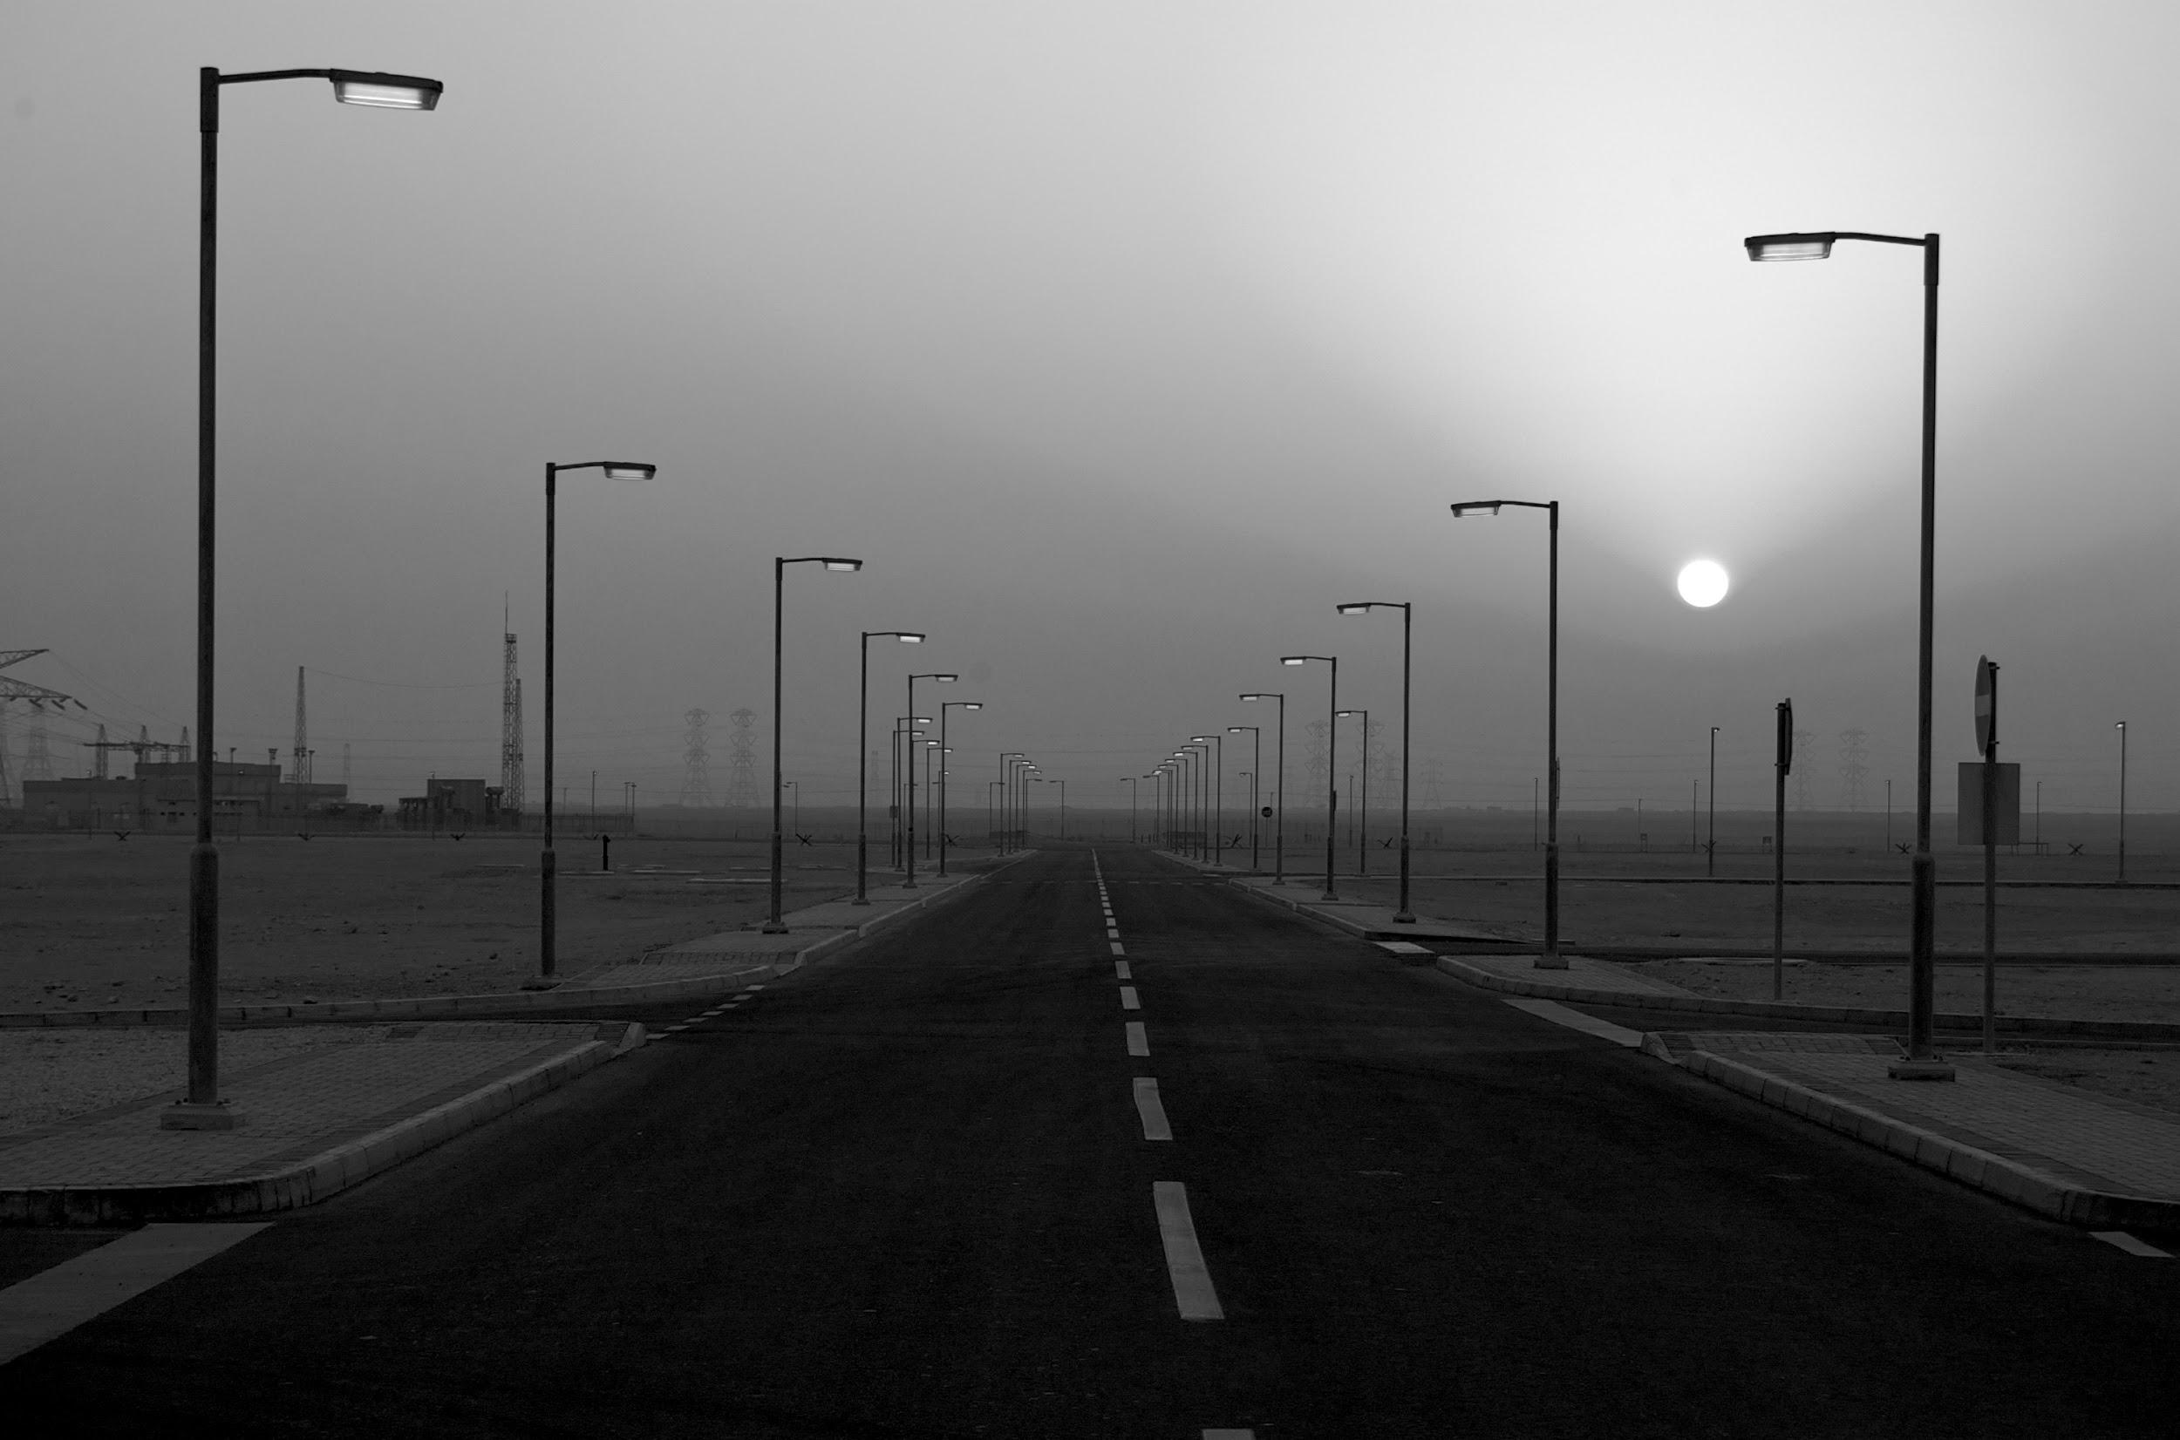
The future belongs to those who create a distributed, equitable, and regenerative economy.
Rejecting volatility and supplanting scarcity through deep wealth.

Slide 14
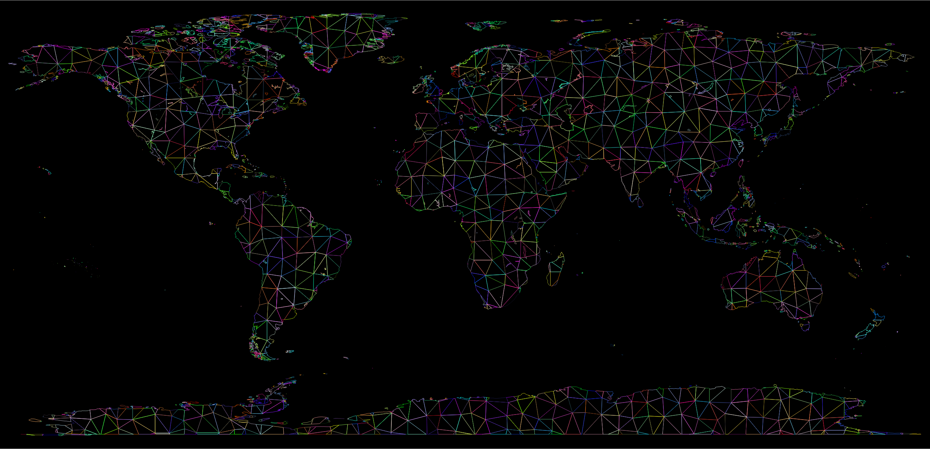
Dive Deeper and Get Involved in Holochain Today
Holo.Host - Whitelisting/ICO info & Technical Papers
Indiegogo - HoloPort hosting boxes & personal developer training
Holochain Chat - Connect with developers and share ideas
Holochain.org - Upcoming global hackathons and other news

